Slide 1
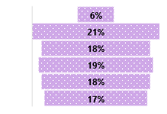
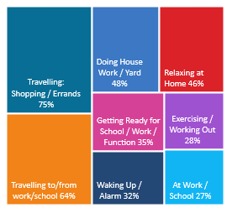
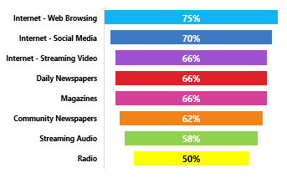
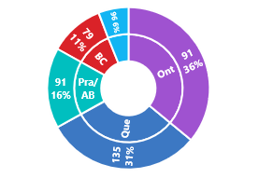
RADIO REACHES 88% WEEKLY: A18+ THAT HAVE SWITCHED INSURANCE COMPANIES PAST 2 YEARS (AUTO/HEALTH/LIFE/HOME/MORTGAGE/TRAVEL)
CONSUMER
PROFI LE
INSURANCE HELD:
AGE BREAKDOWN: AVG AGE 47: 99i
HHI: AVG $103,000 102i
240i
56i
122i
114i
114i
106i
78i
REGION BREAKDOWN: INDEX / % TOTAL
139i
111i
OCCUPATIONS:
129i
115i
117i
123i
105i
80%
163i
20%
39i
121i
83i
94i
94i
84i
115i
99i
112i
97i
APPROX 12% OF CANADIANS A18+ HAVE SWITCHED INSURANCE IN PAST 2 YRS
RADIO
W
O
R
K
S
-
YOUR
TARGET
L
I
STENS
TO
RADIO
A18+ THAT SWITCHED INSURANCE PAST 2 YEARS:
RADIO HAS THE LOWEST LEVEL OF AD AVOIDANCE!
75% of all A18+ THAT SWITCHED INSURANCE IN THE PAST 2 YRS occasionally / frequently AVOID ADS ON THE INTERNET WHEN BROWSING
Listen to Radio while living their lives
Radio Reached 74% of your target Yesterday
88% are REACHED WEEKLY by RADIO
22% of their MEDIA TIME* is spent with RADIO
74% were EXPOSED to RADIO YESTERDAY
Comparing to other audio platforms – past 7 days – AM/FM Radio is @ 88% vs 27% Internet Only Music Service e.g. Spotify
Radio delivers 88% weekly reach against A18+ THAT HAVE SWITCHED INSURANCE IN THE PAST 2 YRS – a higher % than popular social media websites delivered in past 7 days
18% of A18+ that switched insurance companies in the past 2 yrs find Entering contests & winning prizes on Radio important radio attribute -> 26% more likely
SOURCE: NUMERIS RTS CANADA FALL 2020/ A18+ / TOTAL CANADA/ SWITCHED COMPANIES FOR INSURANCE SERVES/PAST 2 YEARS ANY OFAUTO GROUP/PRIVATE DISABILITY/HEALTH , LIFE, HOME, TRAVEL MORTAGE *MEDIA MIX RADIO/ TV/ DAILY NEWSPAPER/ COMMUNITY NEWSPAPER / MAGAZINE/ INTERNET

