Slide 1
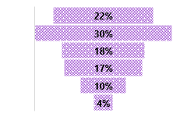
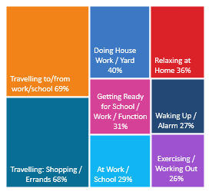
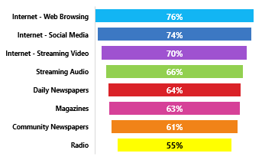
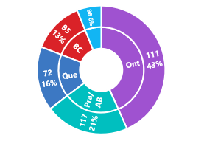
RADIO REACHES 82% WEEKLY: A18+ WHO HAVE RESPONDED TO A RECRUITMENT AD IN THE PAST YEAR
CONSUMER
PROFI LE
TOP INDEXING LIFE EVENTS :
AGE BREAKDOWN: AVG AGE 37: 78i
HHI: AVG $108,000 106i
231i
207i
172i
110i
103i
60i
16i
REGION BREAKDOWN: INDEX / % TOTAL
265i
OCCUPATIONS:
266i
97i
110i
208i
270i
206i
52%
106i
48%
94i
271i
93i
89i
129i
115i
137i
283i
117i
297i
108i
APPROX 16% OF CANADIANS A18+ WHO HAVE RESPONDED TO A RECRUITMENT AD IN THE PAST YEAR
RADIO
W
O
R
K
S
-
YOUR
TARGET
L
I
STENS
TO
RADIO
A18+ WHO HAVE RESPONDED TO A RECRUITMENT AD IN THE PAST YEAR:
RADIO HAS THE LOWEST LEVEL OF AD AVOIDANCE!
76% of all A18+ WHO RESPONDED TO A RECRUITMENT AD IN THE PAST YEAR occasionally / frequently AVOID ADS ON THE INTERNET WHEN BROWSING
Listen to Radio while living their lives
Radio Reached 77% of your target Yesterday
82% are REACHED WEEKLY by RADIO
18% of their MEDIA TIME* is spent with RADIO
66% were EXPOSED to RADIO YESTERDAY
Comparing to other audio platforms – past 7 days – AM/FM Radio is @ 82% vs 35% Internet Only Music Service e.g. Spotify
Radio delivers 82% weekly reach against A18+ WHO HAVE RESPONDED TO A RECRUITMENT AD IN THE PAST YEAR – a higher % than popular social media websites delivered in past 7 days
21% of A18+ who have responded to a recruitment ad in the past year find Possibility to Enter Contests & Win Prizes n Radio important radio attribute -> 45% more likely
SOURCE: NUMERIS RTS CANADA FALL 2020/ A18+ / TOTAL CANADA/ JOB SERCH – RESPONDED TO A RECRUITMENT AD IN THE PAST YEAR *MEDIA MIX RADIO/ TV/ DAILY NEWSPAPER/ COMMUNITY NEWSPAPER / MAGAZINE/ INTERNET

