Slide 1
Stats Canada Sales Monthly: 2020
Green Highest Sales Months – Red Lower Sales Months

Slide 3
Stats Canada Sales 2020 vs 2019 Monthly: Dec 2020
December: Top 5 % Growth | %
Cannabis Stores | 102
Jewellery, luggage / leather goods | 71
Electronics & Appliance Stores | 70
Sporting Goods, Hobby, Book & Music Stores | 56
Specialty Food Stores | 44
December : Bottom 5 % Decline | %
Gasoline Stations | -20
New Car Dealers | -18
Used Car Dealers | -7
Shoe Stores | -3
Building Material & Garden Equip. | -2
Green Positive – Red Negative

Slide 4
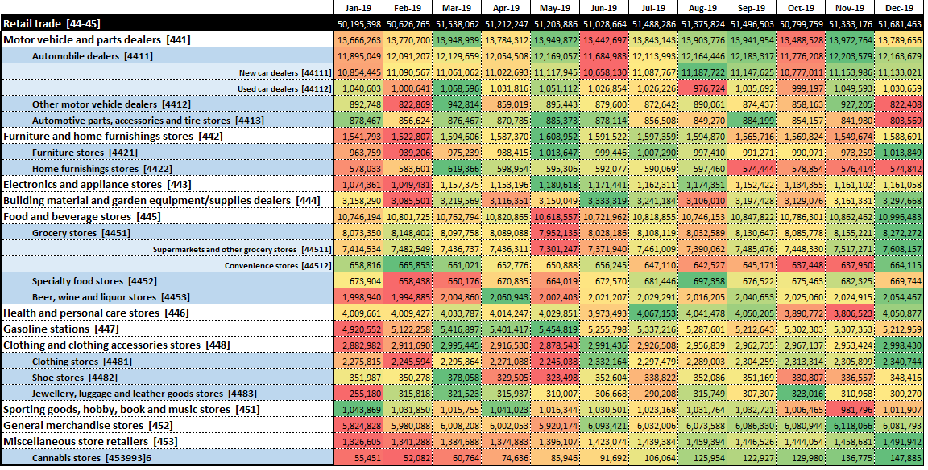
Stats Canada Retail Sales Monthly: 2019
Green Highest Sales Months – Red Lower Sales Months

