Slide 1
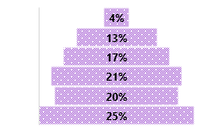
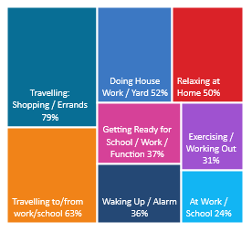
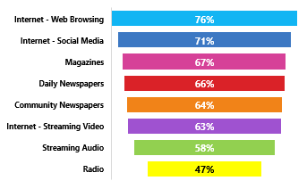
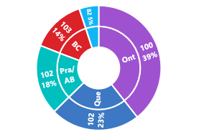
RADIO REACHES 89% WEEKLY: A18+ WHO HAVE SPENT +$250 AT THE HAIR SALON PAST YEAR
CONSUMER
PROFI LE
ESTHETIC SERVICES DONE PAST YEAR:
AGE BREAKDOWN: AVG AGE 52:107i
HHI: AVG $109,000 107i
170i
36i
75i
105i
129i
117i
111i
REGION BREAKDOWN: INDEX / % TOTAL
142i
OCCUPATIONS:
163i
98i
106i
133i
24%
48i
76%
150i
188i
95i
117i
178i
77i
112i
123i
108i
164i
106i
APPROX 23% OF CANADIANS A18+ HAVE SPENT $250 AT THE HAIR SALON IN THE PAST YEAR
RADIO
W
O
R
K
S
-
YOUR
TARGET
L
I
STENS
TO
RADIO
A18+ WHO SPENT +$250 AT THE HAIR SALON IN THE PAST YEAR:
RADIO HAS THE LOWEST LEVEL OF AD AVOIDANCE!
76% of all A18+ WHO HAVE SPENT $250 AT A HAIR SALON IN THE PAST YEAR occasionally / frequently AVOID ADS ON THE INTERNET WHEN BROWSING
Listen to Radio while living their lives
Radio Reached 74% of your target Yesterday
89% are REACHED WEEKLY by RADIO
47% State: Radio feels MORE personal than other media
22% of their MEDIA TIME* is spent with RADIO
74% were EXPOSED to RADIO YESTERDAY
Comparing to other audio platforms – past 7 days – AM/FM Radio is @ 89% vs 20% Internet Only Music Service e.g., Spotify
Radio delivers 89% weekly reach against A18+ WHO SPENT $250+ AT THE HAIR SALON PAST YEAR– a higher % than popular social media websites delivered in past 7 days
34% of A18+ who have used a specialty auto repair shop for their recent repair find Sports News on Radio an important radio attribute -> 6% more likely
SOURCE: NUMERIS RTS CANADA FALL 2020/ A18+ / TOTAL CANADA/ RETAIL SPENDING PAST YEAR INSTORE OR ONLINE $250+ HAIR SALON*MEDIA MIX RADIO/ TV/ DAILY NEWSPAPER/ COMMUNITY NEWSPAPER / MAGAZINE/ INTERNET

