Slide 1


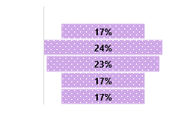
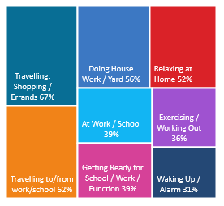
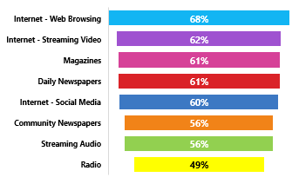
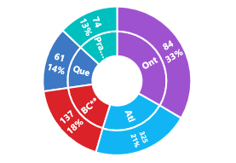
RADIO REACHES 88% WEEKLY: A18+ WHO HAVE PAID FOR LEGAL SERVICES DEALING WITH DEBT CONSOLIDATION / BANKRUPTCY PAST 3 YEARS
CONSUMER
PROFI LE
FINANCIAL – AVG VALUE OF SAVINGS/ DEBT:
AGE BREAKDOWN: AVG AGE 49 : 101i
HHI: AVG $89,000 88i
OCCUPATIONS:
REGION BREAKDOWN: INDEX / % TOTAL
-
100i
148i
138i
101i
75i
121i
122i
1521i
112i
125i
87i
85i
152i
90i
55%
112i
45%
89i
66i
86i
NOTE; HIGHEST INEXING WAS UNEMPLOYED / / AND ABOVE MPE PRIMARY OCCUPATIONS & TRADESPERSON BUT SAMPLE UNSTABLE
APPROX 1% OF CANADIANS A18+ HAVE PAID FOR LEGAL SERVICES DEALING WITH DEBT CONSOLICATION / BANKRUPTCY IN THE PAST 3 YRS
RADIO
W
O
R
K
S
-
YOUR
TARGET
L
I
STENS
TO
RADIO
A18+ WHO HAVE HIRED LEGAL SERVICES TO AID WITH DEBT CONSOLIDATION/ BANKRUPTCY PAST 3 YRS:
RADIO HAS THE LOWEST LEVEL OF AD AVOIDANCE!
68% of all A18+ DEBT CONSOLIDATION/ BANKRUPTCY LEGAL SERVICES USED occasionally / frequently AVOID ADS ON THE INTERNET WHEN BROWSING
Listen to Radio while living their lives
Radio Reached 83% of your target Yesterday
88% are REACHED WEEKLY by RADIO
49% State: Radio feels MORE personal than other media 111i
23% of their MEDIA TIME* is spent with RADIO
83% were EXPOSED to RADIO YESTERDAY
Comparing to other audio platforms – past 7 days – AM/FM Radio is @ 88% vs 44% Internet Only Music Service e.g., Spotify
Radio delivers 88% weekly reach against YOUR TARGET– a higher % than popular social media websites delivered in past 7 days
37% of your targe find the possibility to enter contests & win prizes on Radio an important radio attribute -> 151% more likely
SOURCE: NUMERIS RTS CANADA FALL 2020/ A18+ / TOTAL CANADA/ PAY FOR LEGAL SERVICES – DEBT CONSOLIDATION/ BANKRUPTCY SERVICES *MEDIA MIX RADIO/ TV/ DAILY NEWSPAPER/ COMMUNITY NEWSPAPER / MAGAZINE/ INTERNET ** USE DATA WITH CAUTION *** UNSTABLE DATA

