Slide 1
Listen to This: The Digital Audio Audience in Canada
Fall 2020

Slide 2
Canadians 18+
Audio Streamers
58%
+17.5M
Visited an audio streaming site or app in an average month
Digital Audio in Canada
Reach
Podcast Listeners
33%
+9.9M
Listened to a podcast in an average month
Reach
Smart Speaker Users
+6.5M
21%
In a household with a smart speaker
Reach
Source: Vividata’s Spring 2020 SCC/Metrica Fusion and Study of the Canadian Consumer Fall 2020 Base: Total Canada 18+

Slide 3
Gender
Personal Income
102
102
98
98
Audio Streamers
100
% Reach by Demographic
Occupation
Age
Male Gen Z and Gen Y are the most likely to stream audio through the web or an app.
GenZ (1996-2002)
120
117
107
GenY (1980-1995)
116
105
GenX (1966-1979)
104
95
Boomers (1946-1965)
86
Pre-Boomers (pre 1946)
75
Source: Vividata’s Spring 2020 SCC/Metrica Fusion and Study of the Canadian Consumer Fall 2020 Base: Total Canada 18+

Slide 4
YouTube & Spotify are the most popular
audio streaming services, by web or app, among Canadians 18+.
% in an average month
Website | App
W
A
W A
A
A
A
W A
A
W A
W A
Source: Vividata’s Spring 2020 SCC/Metrica Fusion and Study of the Canadian Consumer Fall 2020 Base: Total Canada 18+
*From Fall 2020 SCC – “Radio/audio streaming services used”

Slide 5
 | % agree: | Index:
Gen Z (1996-2002) | 36% | 139
Gen Y (1980-1995) | 37% | 139
Gen X (1966-1979) | 29% | 109
Boomers (1946-1965) | 18% | 67
Pre-Boomers (pre 1946) | 12% | 45
Statement:
Statement:
“Being able to
stream or listen to the
radio online has changed the way I listen to the radio.”
“Being able to
stream or listen to the
radio online has changed the way I listen to the radio.”
26% 100
All Canadians 18+ that agree:
index
26% 100
All Canadians 18+ that agree:
index
Online streaming impacted how Gen Z
and Gen Y listen to the radio the most.
Source: Vividata’s Spring 2020 SCC/Metrica Fusion
Base: Total Canada 18+

Slide 6
Over 2 in 5 ‘Audio Streamers’ streamed music or listened
to a podcast
from their mobile device in the past month.
Listen to Radio/Podcast
40%
47%
Music Streaming
20%
66%
% ‘Audio Streamers’ 18+
0%
Games
Watched TV
Social Media
Watch YouTube Access
Watched Long Form Videos
News Websites
Read eBook/Listen to Audiobook
Access/Read Magazine or Newspaper
Watched Short Form Video
Source: Vividata’s Spring 2020 SCC/Metrica Fusion
Base: Total Canada 18+, Visited an audio streaming site or app in an average month

Slide 7
Podcasts listeners have tripled
33% | +9.9M
Fall 2020
Canadians 18+
11% | +3.3M
among Canadians 18+ in the past 18 months.
Spring 2018
Canadians 18+
Source: Vividata’s Study of the Canadian Consumer Spring 2018 and Fall 2020
Base: Total Canada 18+
Note: question about podcast was asked differently in Spring 2018 and Fall 2020 Studies.
Spring 2018 Study: “How Receive Audio Content - Podcast”
Fall 2020 Study: “When last listened to podcast – Last Month”

Slide 8
Gender
Personal Income
116
112
85
101
Podcast Listeners
96
% Reach by Demographic
Occupation
Age
Podcasts are more likely to reach Gen Z and Gen Y males with higher income.
131
GenZ (1996-2002)
135
119
GenY (1980-1995)
142
117
GenX (1966-1979)
101
88
Boomers (1946-1965)
66
Pre-Boomers (pre 1946)
50
Source: Vividata’s Spring 2020 SCC/Metrica Fusion and Study of the Canadian Consumer Fall 2020
Base: Total Canada 18+, When last listened to podcast – Within Last Week

Slide 9
CBC/Radio Canada & TED Talks are the most popular podcasts
among Canadians 18+ in the past week
% of Podcast listeners 18+
CBC/Radio
Canada
TED Talks
BBC
NPR
How Stuff Works
New York
Times
This American Life
Canadaland
The Nerdist
Source: Vividata’s Study of the Canadian Consumer Fall 2020
Base: Total Canada 18+, When last listened to podcast – Within Last Week

Slide 10
% ownership of Smart Devices
Smartphone | 85%
Smart TV | 28%
Fitness Band | 26%
Smart Watch | 23%
Smart Speaker | 21%
Smart Home Hub/Controller | 5%
9 out of 10
Canadians 18+ own a
smart device
Source: Vividata’s Study of the Canadian Consumer Fall 2020 Base: Total Canada 18+

Slide 11
Those who own a smart speaker have almost doubled in the past 12 months.
21% | +6.5M
Fall 2020
Canadians 18+
11% | +3.3M
Fall 2019
Canadians 18+
Source: Vividata’s Study of the Canadian Consumer Fall 2019 and Fall 2020
Base: Total Canada 18+

Slide 12
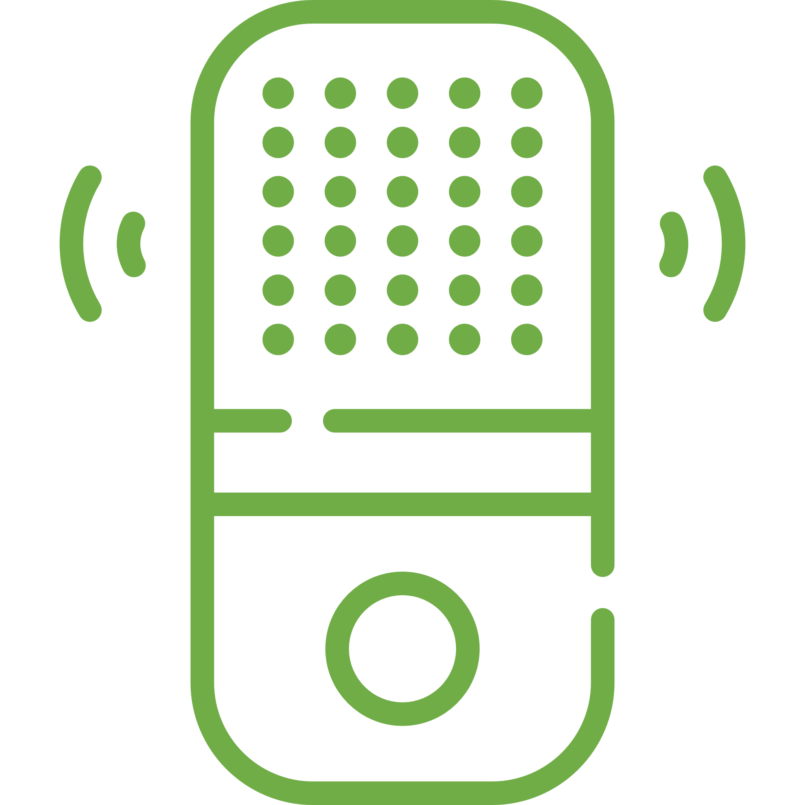
Gender
Personal Income
Smart Speaker Owners
108
138
91
108
86
% Reach by Demographic
Occupation
Age
Younger professionals with higher incomes are more likely to own a smart speaker
124
GenZ (1996-2002)
120
121
GenY (1980-1995)
129
124
GenX (1966-1979)
115
86
Boomers (1946-1965)
70
Pre-Boomers (pre 1946)
55
Source: Vividata’s Study of the Canadian Consumer Fall 2020 Base: Total Canada 18+

Slide 13
Music streaming is the most popular command that smart speaker owners use.
Listen to a Podcast
11%
Listen to Live Radio
25%
Music Streaming
58%
% Who Own
a Smart
Speaker 18+
0%
Play a Game
Sports Updates
News Updates
Listen to an Audiobook
Made a Phone Call
Set a Timer or Alarm
Weather Updates
Make a Purchase
Controlling Smart Home Devices
Source: Vividata’s Study of the Canadian Consumer Fall 2020
Base: Total Canada 18+, Own a Voice-Activated Smart Speaker

Slide 14
Google Home is the #1 smart speaker
% of Smart Speaker Owners 18+
among those who own one in Canada.
Source: Vividata’s Study of the Canadian Consumer Fall 2020
Base: Total Canada 18+, Own a Voice-Activated Smart Speaker

Slide 15
 | % agree: | Index:
Audio Streamers | 44% | 106
Podcast Listeners | 48% | 112
Smart Speaker Users | 51% | 120
Statement:
Statement:
“Being able to
stream or listen to the
radio online has changed the way I listen to the radio.”
“I feel confident using new technology products.”
42% 100
All Canadians 18+ that agree:
index
26% 100
All Canadians 18+ that agree:
index
The Digital Audio Audience are early adopters and tech savvy
Source: Vividata’s Fall 2020 SCC/Metrica Fusion and Study of the Canadian Consumer Fall 2020
Base: Total Canada 18+

Slide 16
 | % agree: | Index:
Audio Streamers | 22% | 111
Podcast Listeners | 24% | 123
Smart Speaker Users | 29% | 137
Statement:
Statement:
“Being able to
stream or listen to the
radio online has changed the way I listen to the radio.”
“I love to buy new gadgets and appliances.”
20% 100
All Canadians 18+ that agree:
index
26% 100
All Canadians 18+ that agree:
index
The Digital Audio Audience are early adopters and tech savvy
Source: Vividata’s Fall 2020 SCC/Metrica Fusion and Study of the Canadian Consumer Fall 2020
Base: Total Canada 18+

Slide 17
Audio is everywhere, from streaming music, to radio, to podcasts from sites, apps or smart speakers.
Listening habits of younger generations have been the most impacted by audio streaming services.
The podcast audience continues to grow, providing marketers a unique opportunity to reach an engaged and valuable segment of the population.
Smart speaker adoption is on the rise, allowing audiences a new way to listen; smart speaker owners are the most likely to be high income professionals.
At varying degrees, music streamers, podcast listeners, and smart speaker owners are more likely than the general adult population to be young, higher income and tech savvy.
Some final thoughts …

Slide 18
Let’s take a closer look at the data, together.
To learn more about this report, our insights, or how you can get access to Vividata’s Survey of the Canadian Consumer for Fall 2020 or the Metrica SCC Fusion database, feel free to reach out to us at:
info@vividata.ca
416.916.3205

